Slide 1

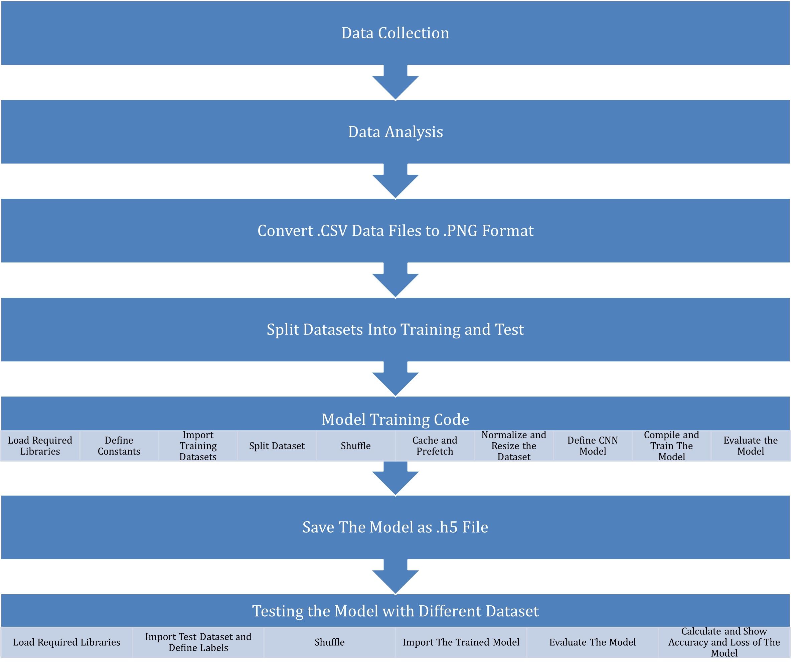
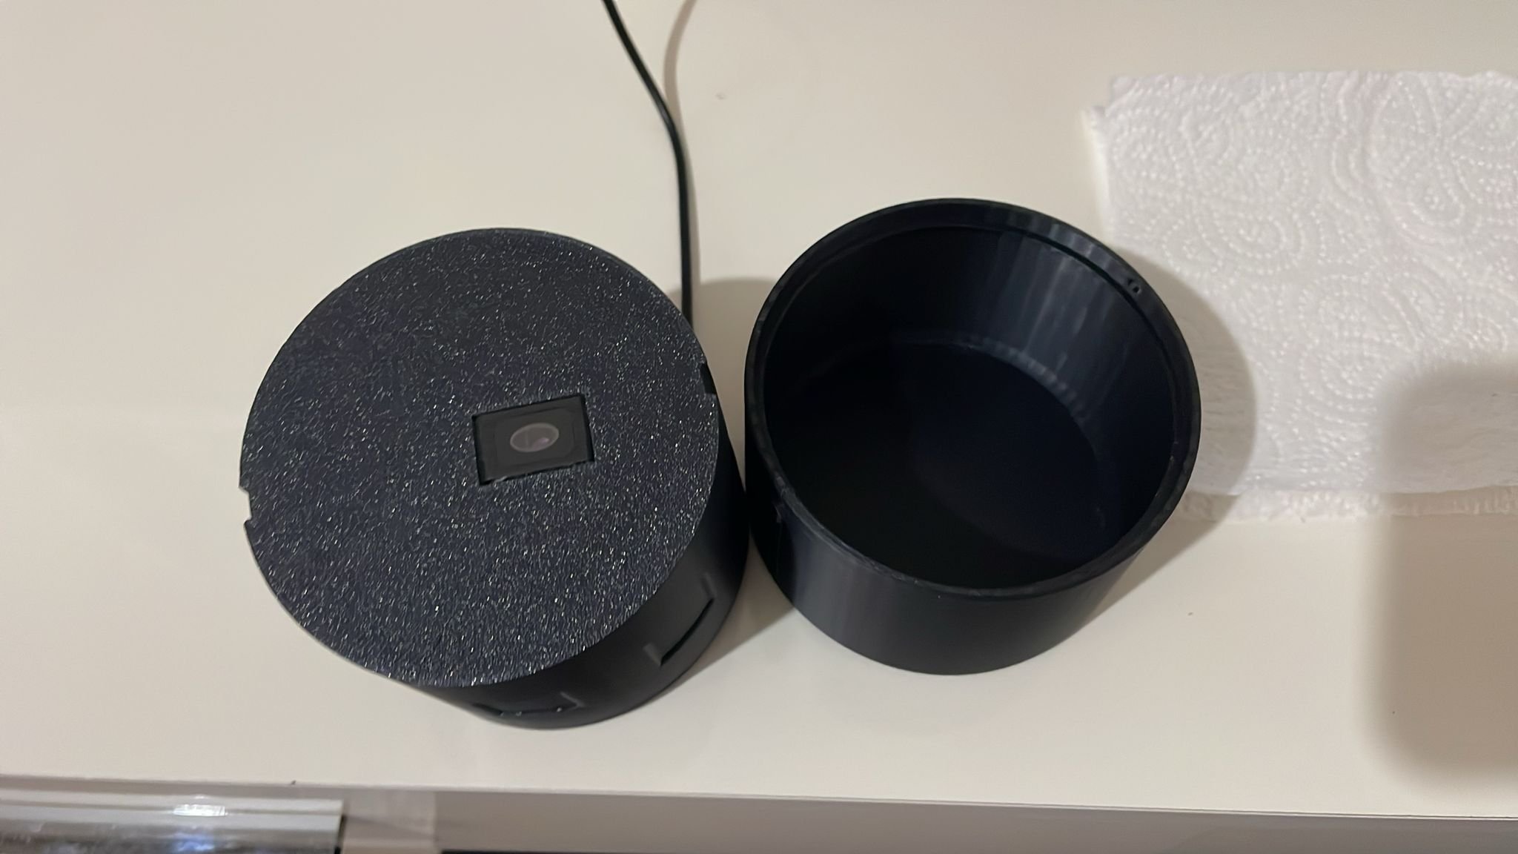
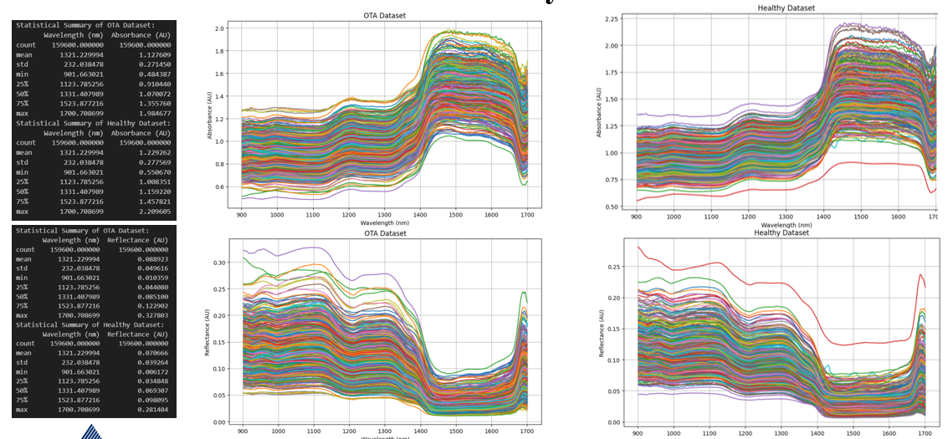
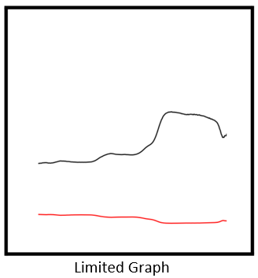
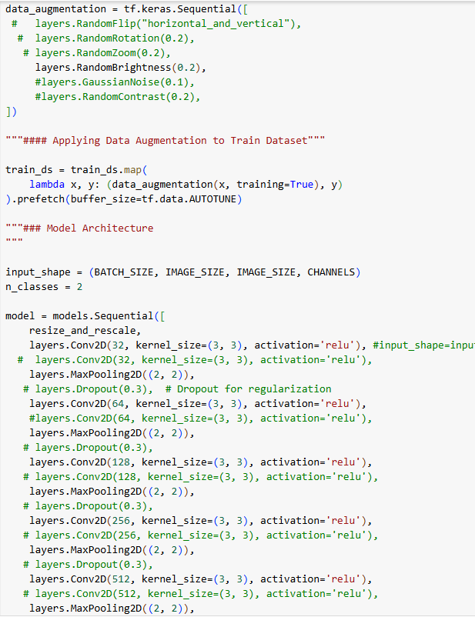
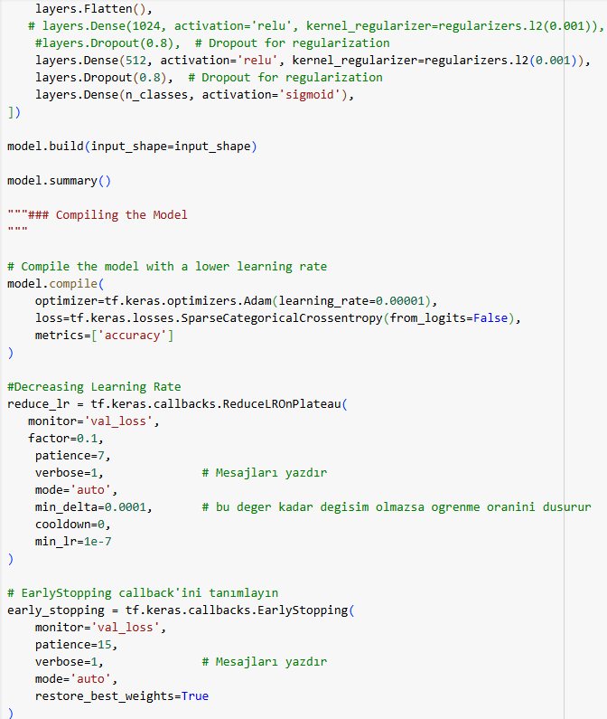
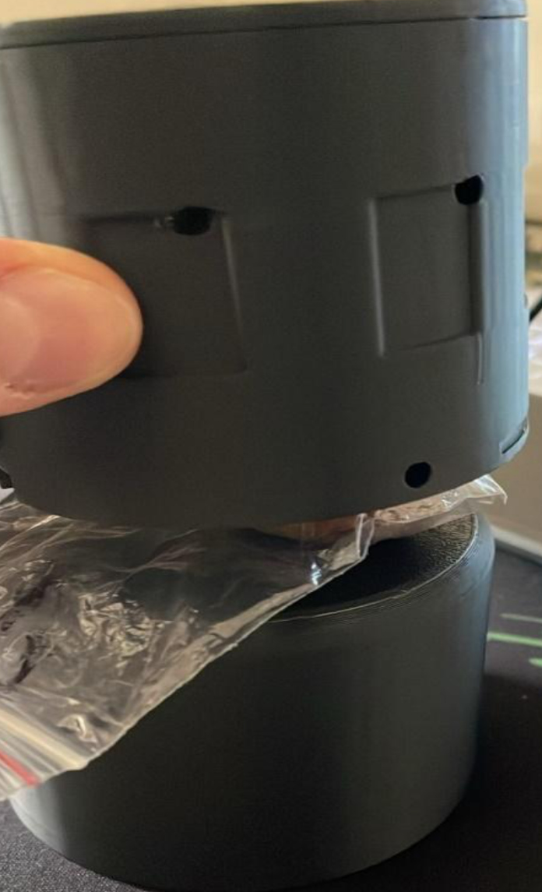
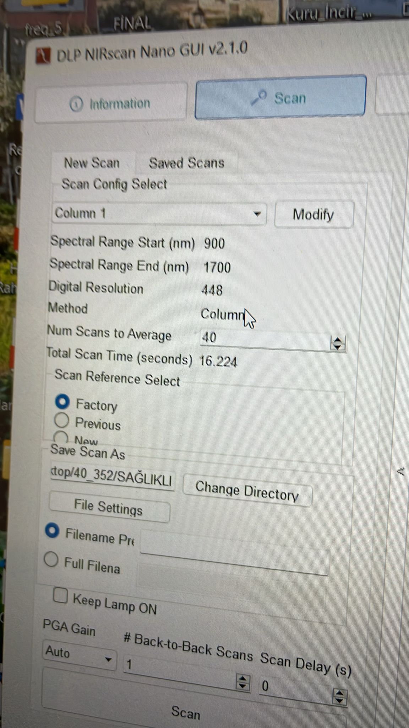
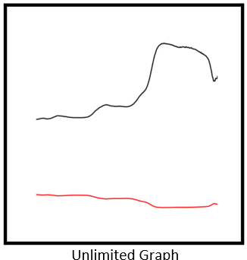
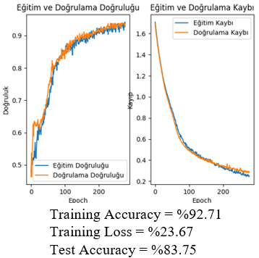
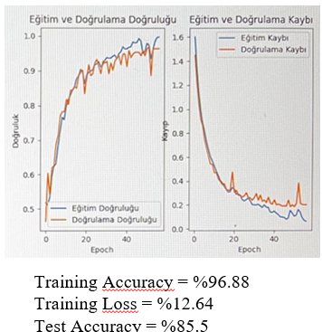
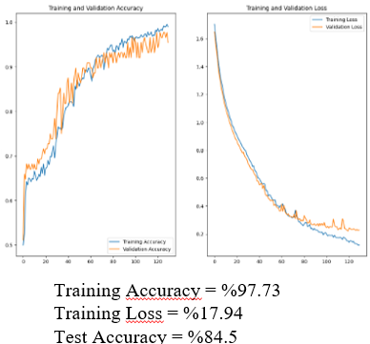
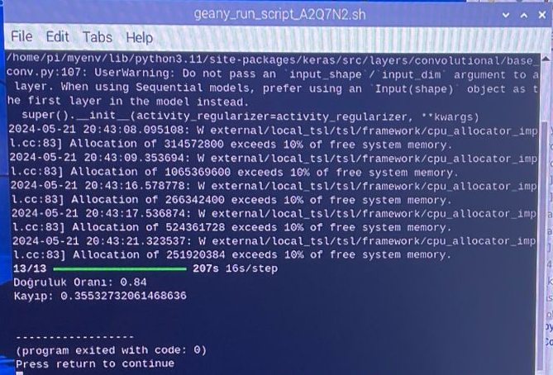
Determination of Ochratoxin in Raisins Through NIR Scan with AI Based Methods
Ali Baki TÜRKÖZ
Yeditepe University, Istanbul, TURKEY, alibaki.turkoz@std.yeditepe.edu.tr
Supervisor: Asst. Prof. Dr. İpek BAZ
Yeditepe University, Istanbul, TURKEY, ipek.baz@yeditepe.edu.tr
INTRODUCTION
Raisins, highly sensitive to fungal development, are frequently contaminated by Ochratoxin A (OTA), a carcinogenic and toxic mycotoxin. Given Türkiye's significant role in global raisin production and export, controlling OTA contamination is crucial for public health and the economy. Current OTA detection methods, like HPLC and ELISA, are time-consuming, inefficient, and inadequate for large-scale inspection. This study aims to develop a faster, more reliable AI-based detection system using NIR Spectroscopy to identify and predict mycotoxin presence in raisins, improving product safety and quality. Periodic screening and advanced detection methods are essential to maintain international demand and prevent economic losses from contaminated exports.
DESIGN
DATA COLLECTION
Data was collected using the DLP NIR Scan Nano spectrometer, resulting in three CSV files: Absorbance, Reflectance, and Density. The study focused on Absorbance and Reflectance data to detect ochratoxin in dried grapes. This data was crucial for training the AI model, impacting its accuracy and reliability.
DATA ANALYSIS
The dataset, including Absorbance, Reflectance, and Wavelength data, was analyzed. Erroneous data were removed, and the dataset's decomposability was checked. The cleaned dataset was plotted on a single graph, ensuring a healthy training process.
CONVERT CSV DATA FILES TO PNG FORMAT
CSV files were converted to PNG format. The data was visualized on graphs with wavelength on the X-axis and Absorbance (Blue) and Reflectance (Red) on the Y-axis. This visualization facilitated better analysis and prepared the dataset for AI model training.
SPLIT DATASET INTO TRAINING AND TEST
700 graph images were divided into 500 for training and 200 for testing. This separation was essential for training the model and evaluating its performance on unseen data.
TRAINING CODE PREPARATION
Downloaded necessary Python libraries.
Imported 1000 images (500 ochratoxin-infected, 500 healthy).
Defined constants for the code.
Split and preprocessed the dataset, including normalization.
Created a CNN model for 512x512 images.
Trained the model with Early Stopping after 300 epochs.
Evaluated and saved the best-performing model.
TESTING THE MODEL WITH DIFFERENT DATASET
Downloaded necessary Python libraries.
Imported and labeled the test datasets.
Shuffled the datasets.
Imported the trained model.
Tested the model, calculated accuracy and loss values to evaluate performance on new data.
METHODS
Data Collection
Custom Black Box Design: It was determined that using a black closed box yielded healthier results. Therefore, a specially designed box was created to prevent light from entering, ensuring a stable environment for data collection. Raisins were placed in a plastic bag, pressed on the sensor, and the box was closed to collect data in a light-free environment.
Spectral Data Collection: Spectral data of the packaged raisins were collected using a spectrometer within a wavelength range of 900-1700 nm, with 40 scans and 228 digital resolution. The spectrometer was placed in contact with the raisins through the plastic bags, and two back-to-front data readings were obtained from each raisin, resulting in 700 data points from 350 raisins per class, totaling 1400 data points from 700 raisins for both classes.
Data Analysis
The collected spectral data was saved in CSV format. Data analysis was applied by using Python so that it could make sure that this information is accurate and consistent. Data analysis included max, min, std dev, absolute value, 25%, 50%, 75% and 100% values.
After the analyses, absorbance and reflectance data were plotted on a single graph to examine the consistency and distribution of the data. After these analyses, missing and erroneous data were identified and removed, and reliable data were collected instead.
Dataset CSV to PNG Coverting
The .CSV files from the dataset were converted into .PNG image files with dimensions of 512x512 pixels. Each image contained both absorbance and reflectance data for each measurement. This conversion allowed the observation of the changes in absorbance and reflectance in a single image.
Two types of plots were generated:
* Plots with no axis limitations (Unlimited Graph)
* Plots with fixed axis limitations: Y-axis range of 0-2.5 AU and X-axis range of 900-1700 nm (Limited Graph)
Model Training and Testing Process
The prepared images were divided into 500 training and 200 test data sets. The training data set was divided into
70% training, 20% validation and 10% test sets.
Python programming language, Visual Studio and Google Colab platform were used in the training process of the models.
Customized CNN model produced the best output. In this model, 92.71% training accuracy and 23,67% loss were observed. When the saved model was tested with a new dataset containing 200 data not seen by the model, 83.75% test accuracy was achieved.
RESULTS
In the loss and loss of validation graphs, a simultaneous decrease is observed, indicating the effectiveness of the model and the training process. The lack of a sudden spike in accuracy and validation accuracy is due to the careful selection of optimizers, parameters, hyperparameters and regularizers. This shows that the training process was carried out in a stable and controlled manner.
The model performed well as evidenced by accuracy values ranging between 83-86 percent on the test dataset and 93-98 percent on training dataset.
After the training, the saved H5 model file was uploaded to Raspberry Pi and the model was tested. The results are shown above.

